Slide 1




Python for R Users
‘Dayo Oguntoyinbo, Data Scientist
doguntoyinbo@mango-solutions.com

Slide 2
Agenda
Overview
Python Ecosystem
Hands-on Demo
Resources
Q/A

Slide 3
Overview
Workshop designed to introduce Python as “additional” tool to R.
Introduces the Python ecosystem and its versatility as compared to R.
Provides demos on Importing, Manipulating and Visualizing Data as well as some basic Statistical Analysis and Machine Learning.
Demonstrate some features of Python and some of the in-built objects and methods.
Show cloud capabilities and workflow (possibility)

Slide 4
Overview: mentiPyR survey
www.menti.com
Code:

Slide 5
Python Ecosystem
High-level, versatile, object-oriented programming language
Powerful, readable and easy to learn
Extensive Ecosystem of Libraries, Frameworks and Tools
Data Analysis, Web Scraping, Web Development, Machine Learning, Scientific Computing, DevOps, IoT Development, Cloud Computing, Deep Learning Frameworks, Natural Language Processing
Functions, DataFrames, Maths functions, Date & Time, et cetera

Slide 6
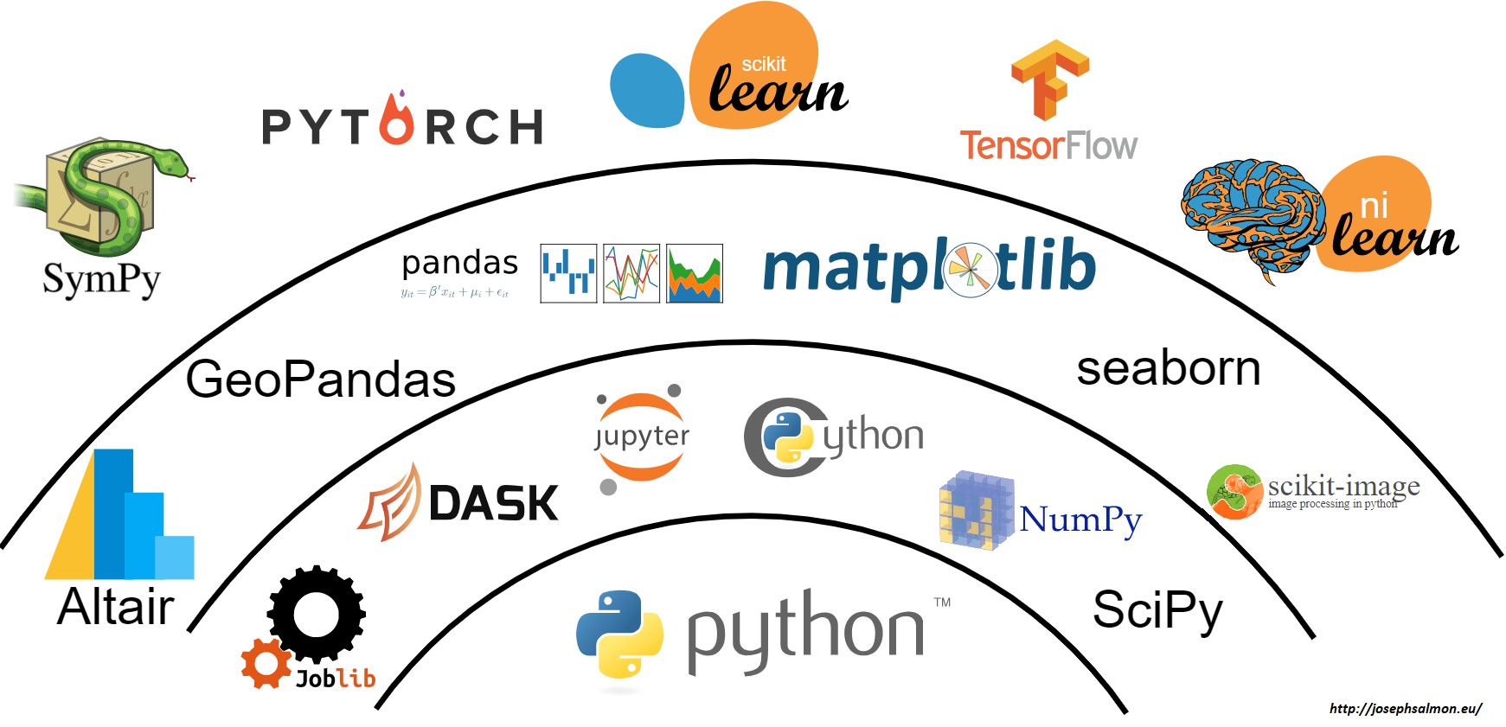
Some elements of Python Ecosystem

Slide 7




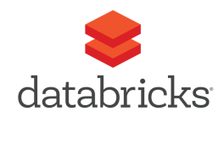



Python IDEs and code editors possibilities

Slide 8
Python Virtual Environments
Python Virtual Environment helps manage packages.
Managing virtual environments is possible with Python’s venv or with conda.
Virtual Environment tools are used to create an isolated workspace. With the ability to install modules locally, export a working environment, and execute a Python program in that environment.
Made possible with the use of environment.yml or requirements.txt file.
Use of pip and conda commands

Slide 9



Hands-on Demo

Slide 10
Resources
https://github.com/MangoTheCat/python-for-r-users-workshop
Additional Demo Notebooks
Others to follow

Slide 11

Questions

Slide 12

FINAL PAGE – PUT TO BACK OF DOCUMENT

Slide 13
FINAL PAGE – PUT TO BACK OF DOCUMENT

